Slide 1
DSM 4.0 –
Your NAS, Your Cloud
Product Management Team

Slide 2

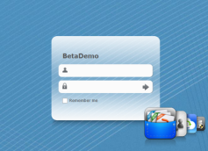
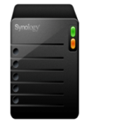
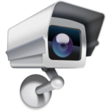





What’s New in DSM 4.0
A Break with the Past
Cloud Service
Office Applications
Intelligent
Video Security
Enjoy Your Digital Life

Slide 3
DSM 4.0
Breaks with the Past

Slide 4
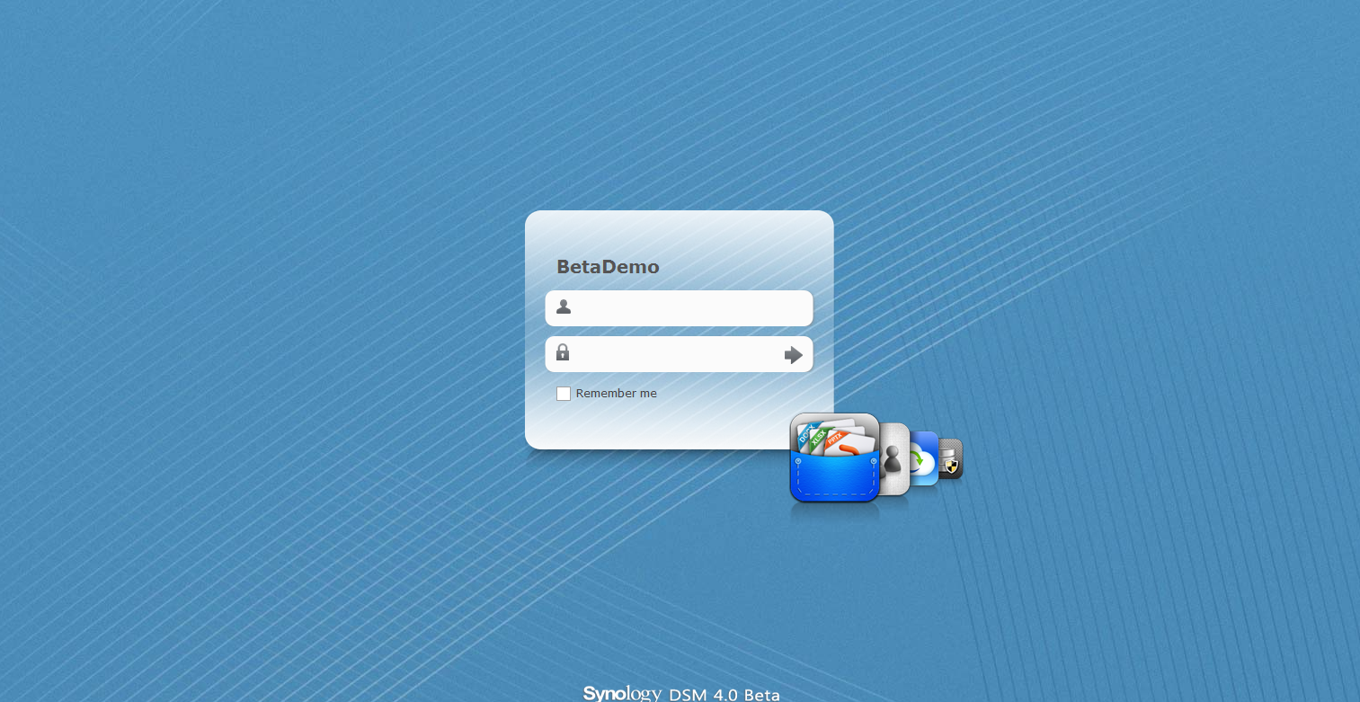

Slide 5
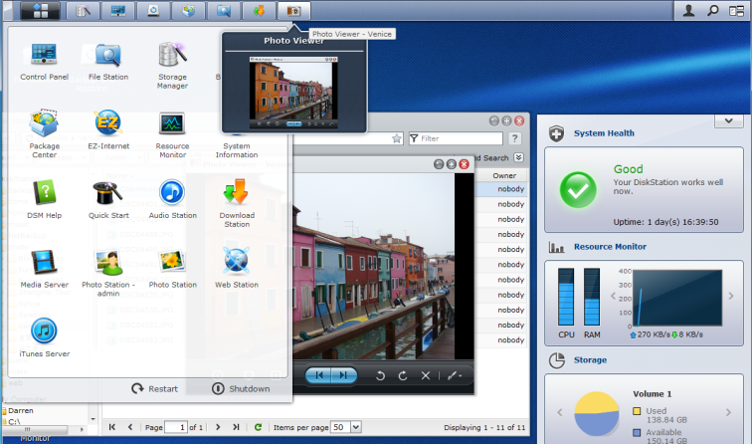
New & Easier to Use
Renovated Desktop

Slide 6
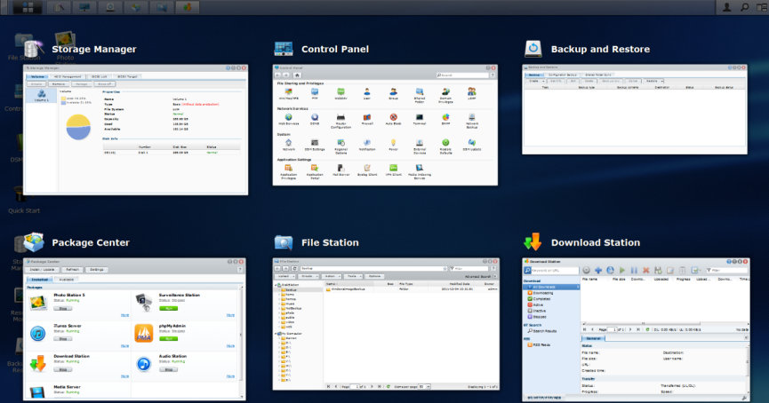
See Everything in Pilot View by CSS3 Transform

Slide 7
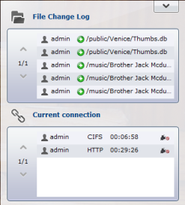
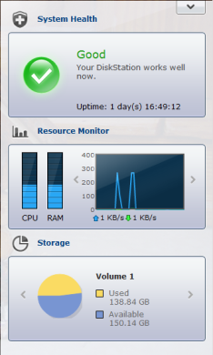
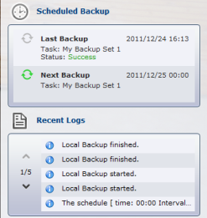
Overview at a Quick Glance
Desktop widget provides an overview of your system health:
  System health
  Resource monitor
  Storage usage
  Backup task
  Active connections
  Recent system & file change logs

Slide 8
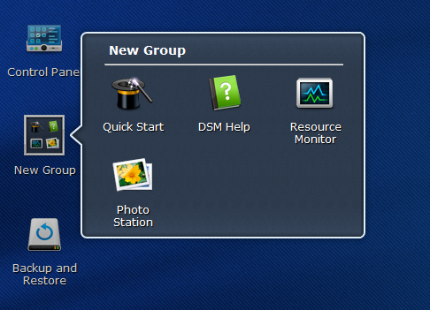
Group of Shortcuts
Even smarter to find what you are looking for

Slide 9

Apps are Now Packages
Photo, Audio, Download, Surveillance Station & iTunes, Media Server are now available as independent packages, easier to be upgraded in the future (after DSM 4.0)
Your Synology NAS can now either be customized as a dedicated home server or a business server for enterprise

Slide 10
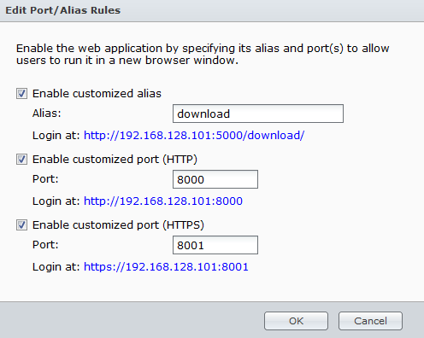
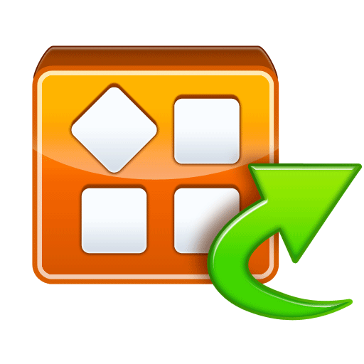




Independent Application Login
Skip the DSM login for better privacy
Quicker and easier sharing to your friends, ex. darren.DSmyNAS.com/audio

Slide 11

Personal
Cloud Services
Cloud Station
ezCloud

Slide 12

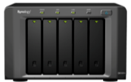



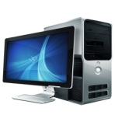


Cloud Station
Cloud Station

Slide 13




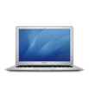

Cloud Station
Bring and share your files anywhere
Instantly mirror/sync files between your PCs and mobile devices
Protect your synced files with multiple versions on your private cloud
Easily install Cloud Station on DiskStation from package center
Cloud Station

Slide 14








Cloud Station
Individual Sync Service
Free and secured Dropbox alternative to your employees
Notes:
Domain account

Slide 15

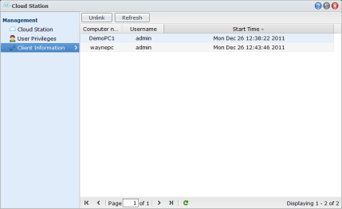
Available in Package Center
Enable Cloud Station on your Synology NAS with the Synology Cloud Station Package
Grant users the privileges to use Cloud Station
Notes:
192.168.16.43 admin/e

Slide 16
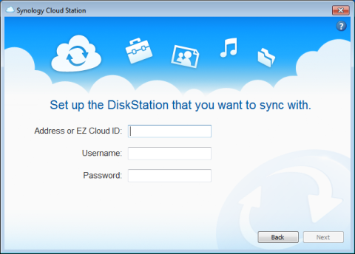
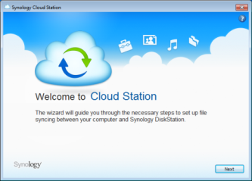
Cloud Station on PC Client
Files sync between your PCs and Cloud Station on Synology NAS
Address or ezCloud ID:

Slide 17
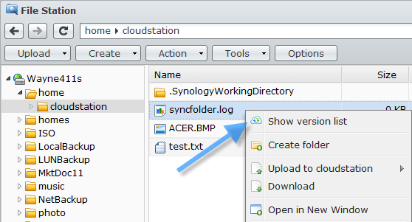
Restore to Yesterday’s Version
File Station, you could easily restore the current file to a previous point in time from

Slide 18
Synology ezCloud
Synology ezCloud provides cloud services help you to easily access and manage your DiskStation
QuickConnect
DDNS
by
Synology
MyDS Center
Push Notification

Slide 19


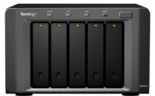


QuickConnect
Synology Relay Service
Access your Cloud Station and DS file without the hassle of going through port-forwarding settings on your router
QuickConnect
Service

Slide 20

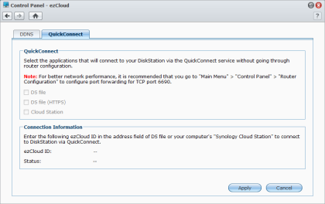
QuickConnect (Cont’d)
Synology Relay Service
Enter your ezCloud ID and your are ready to go
Address or ezCloud ID:
095687531
Connected

Slide 21
Free DDNS powered by Synology
A free Synology DDNS service
A reliable 24/7 Synology DDNS service
Customize your own domain, chad.DSmyNAS.org
Available Domains
DSmyNAS.com | DSCloud.biz | FamilyDS.com
DSmyNAS.org | DSCloud.me | FamilyDS.org
DSmyNAS.net | DSCloud.mobi | FamilyDS.net

Slide 22
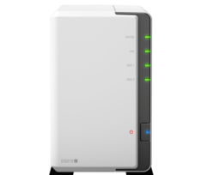



MyDS Center
DDNS service, push notification, product & eNews registration
Heartbeat feature allows you to monitor the online status of your Synology NAS anywhere
Offer Synology membership service & product registration, available at MyDS.synology.com
My NAS is Live!
Robert (MIS)
on vacation
chad.DSmyNAS.org
MyDS Center

Slide 23



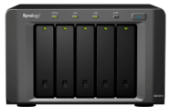
New Push Notification
A Faster Way to Stay Connected
Send instant messages to your mobile devices or PC when a critical event occurs on your Synology NAS
  via Skype & Windows Live Messenger
  via SMS or e-mail
  via DS finder on iPhone/iPad
5

Slide 24

Office
Applications

Slide 25
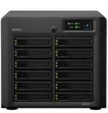
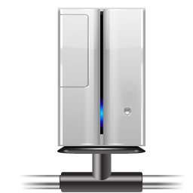




LUN Backup
Protect your business data on the fly with point-in-time copy technology
Perform LUN backup on Synology NAS to leverage computing resources
Efficient and cost effective LUN backup solution
iSCSI LUN
LUN Backup

Slide 26
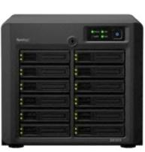
LUN Backup (Cont’d)
Features incremental and space re-claim to maximize backup efficiency
Available on both local and network backup
LUN Backup
Deleted
Newly created block

Slide 27
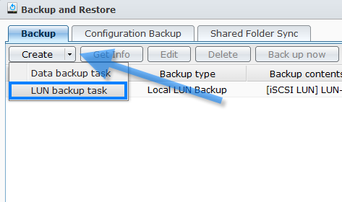
LUN Backup (Cont’d)
Create a Backup Task
You could create a LUN backup task from Backup and Restore application in main menu

Slide 28
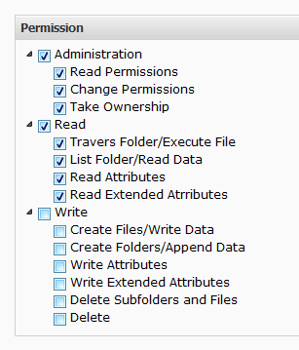
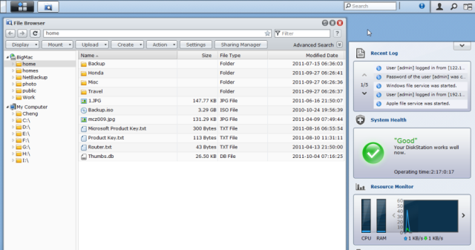
Embedded Windows ACL Editing
Now you will never have to leave Synology DiskStation Manager for Windows ACL editing, it means you may edit Windows ACL on the “move”

Slide 29
Embedded Windows ACL Editing
(Cont’d)
Easy-to-use design for everyone
Remote privilege management via web access

Slide 30


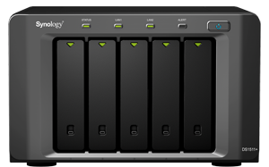

Antivirus Essential
Available in Package Center
Proactive virus scan to keep your Synology NAS safe and secure in your network
Free antivirus solution from Synology

Slide 31



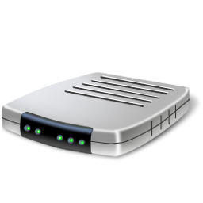
Hotspot
Now your Synology NAS can allow wireless devices to connect to a wired network using Wi-Fi technology
* Compatible wireless dongles will be published on www.synology.com

Slide 32
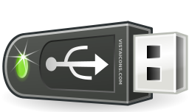
Hotspot (Cont’d)
Just need a wireless dongle which turns your Synology NAS into a WAP right away
Easy wireless deployment without additional wireless router
WEP and WPA for security
Plug & Play
* Compatible wireless dongles will be published on www.synology.com

Slide 33





Virtual Private Network Client
Build your cost effective private network over Internet across the globe
Secure all your data transfers between your branch offices
LAN
LAN
VPN Client
VPN Server

Slide 34
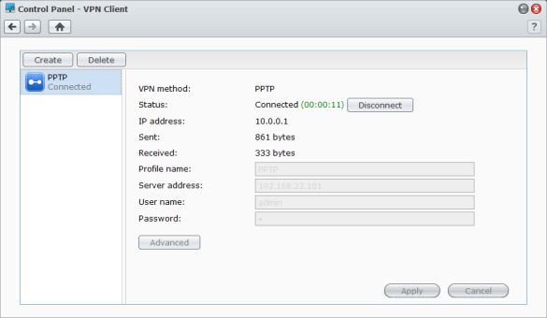
Virtual Private Network Client (Cont’d)
Fast switch between different VPN servers by keeping multiple VPN profiles

Slide 35
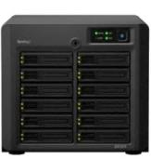
Configuration Backup
Configuration backup with control panel settings provides easy migration and fast system recovery
Schedule system configuration backup on a weekly basis to reduce the side effect of the system rollback
DSM 4.0
Control Panel Configuration
DSM 3.1
Account & Permission
Notes:
Disable color

Slide 36
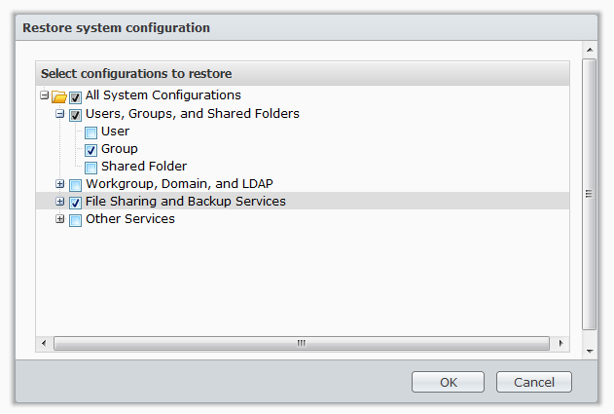
Configuration Backup (Cont’d)
Instead of performing a full system rollback, you can now only restore the partial system configuration that is only needed to be restored

Slide 37


Improve Management Simplicity
SMART test by schedule
  Scan HDD for potential issues on a timely basis to prevent data crisis
Syslog Client
  Synology NAS can now report to your Syslog server and keep everything log in one place for easy management
Notes:
SMART 192.168.10.128 admin/a

Slide 38



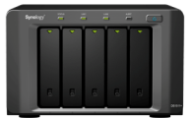



Improve Management Simplicity
(Cont’d)
Airport Extreme
Airport Express
Time Capsule
EZ-Internet Now Supports Apple Routers
  Configure Apple routers to publish your Synology NAS on the Internet
  Synology NAS is now ready for every MAC user
Connection Monitor
  Real-time monitor who is accessing your NAS
  Kill the connections from unwanted users
  DSM/FTP/Samba/AFP support

Slide 39

Intelligent
Video Security
Notes:
http://192.168.22.210:5000/webman/index.cgi

Slide 40
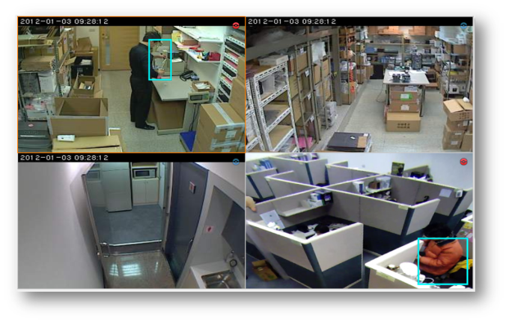
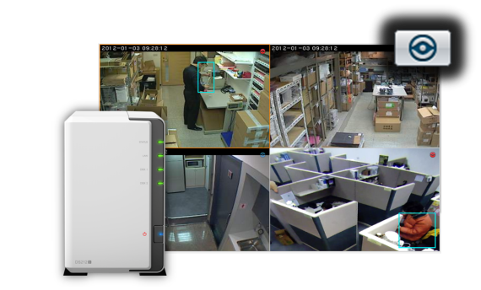
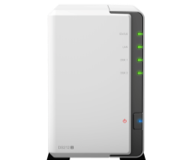
Live View Analytic
Image analysis in Live View helps security guards spot the suspicious movements on multi-channel

Slide 41

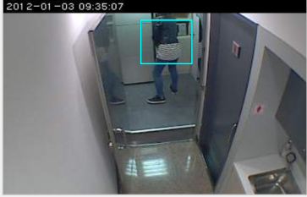

Validate Video Evidence in Court
Invisible digital signature (validate by Evidence Integrity Authenticator) is planted on all recorded videos or images will ensure evidence is admissible in a court of law

Slide 42
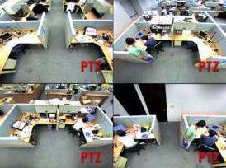
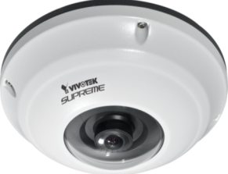
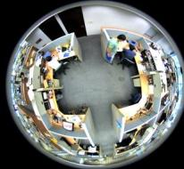

Fisheye Camera Dewarping
  View multiple video angles from just a single camera, reduce the cost of your IP camera deployment
Notes:
Less camera license, more video channels

Slide 43

Batch Camera Editing
System Integrator can now add/edit multiple cameras with the same model at once, to save valuable time on each project installation
EDIT
ADD

Slide 44
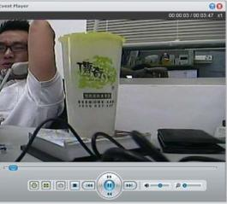

Instant Event Preview
No more waiting for recording to be finished, you can now play the current recordings on the fly
Timely Playback!
Recording…
0 Min
15 Min
30 Min

Slide 45
1000+ IP Camera Integration
More professional and economical IP cameras for our users to choose from
New Brands includes Samsung, 3Svision, iMege, and Apexis
Total of 22 brands have been updated with newer models
Brands | New Models
Etrovision | 55
A-Linking | 24
Apexis | 22
3Svision | 20
SAMSUNG | 20
TRENDnet | 18
Brickcom | 16
D-Link | 10

Slide 46




Enjoy Your
Digital Life

Slide 47

Back to File Station
Evan easier! Instant cut, copy, or paste folders/files between your Synology NAS & your local computer
No more waiting! Simply upload/download many files/folders at once, Synology NAS will perform it in a sequential order
File Browser is now renamed to
File Station

Slide 48

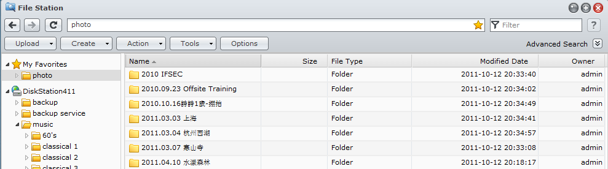
Back to File Station (Cont’d)
Personal favorites is added for quick access
Files or folders can now be dragged to desktop for shortcuts

Slide 49


File Station Makes Sharing Easy
Share a file among your friends via a private/shared link without DSM user credentials
The shared link could be set with a expiration date as well as a password for the privacy concern

Slide 50
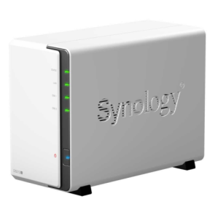




Photo Station, Social Station
Click to publish photos to your Picasa album, or tweet a photo to Twitter, it couldn’t be easier
Texts at social network, leave Synology NAS to handle your multimedia

Slide 51

Photo Station by Original
View photos in the original aspect ratio
Display the title of the photos
Take only 1s to rotate or delete a photo with the new quick menu

Slide 52


Photo Station Enhancements
Videos on Photo Station can now be played by the majority of the Smartphone
Support MPEG4 for video conversion

Slide 53


Download Station Enhancements
Drag and drop your torrents to the designated folder and downloads will start automatically
Added Encrypted FTP and SFTP support

Slide 54
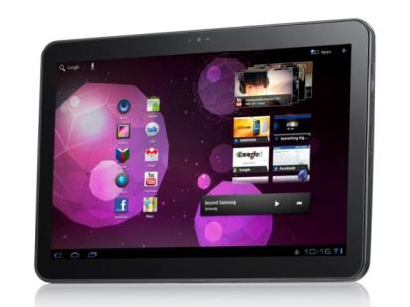
Mobile Apps

Slide 55
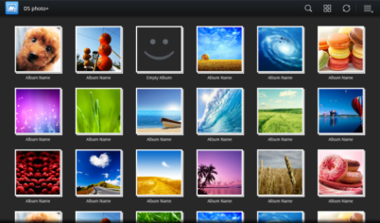
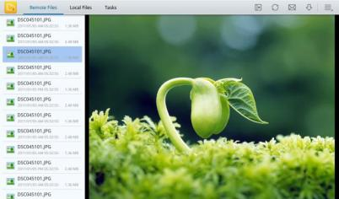
We Are Now on Android Tablet
Apps migrated onto Android Tablets:
  DS file
  DS photo+

Slide 56
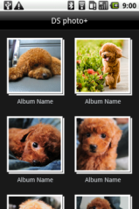

DS photo+ on Android
Improvements
Display photos in either list or thumbnail view, your pick
Download the original photo for offline browsing
Customize the sort order to fit your needs
Remove the unwanted photos on the go

Slide 57

DS file on Android
Improvements
Embedded photo viewer & audio player
Video streaming or open documents on the fly
Download multiple files at once to save your time
Support list view in landscape mode for better browsing experience

Slide 58


Stay with Push Notification for DS finder, DS cam on iPhone/iPad
Stay connected to your Synology NAS via push notification. Receive instant updates of your system status anywhere you go

Slide 59

Connect to iCloud
DS file for iPhone/iPad
  Sync your important files to iCloud, blend in with your iOS device
Landscape & full screen view are now available
Support subtitles (srt only) when streaming video on the fly

Slide 60


DSM mobile - Live!
DSM mobile is now more powerful so that IT staffs are able to complete more jobs from their iPhone, iPad, or Android devices on the go
Monitor your system resources live:
  Network traffic
  Recent logs
  Health of your iSCSI target

Slide 61



DSM mobile - Management
Remote management from DSM mobile:
  To stop or run apps from the built-in Package Center
  User/Group editing
  IP auto block
  Mount/dismount encrypted shares

Slide 62

Kindle Fire Support
Among the first to publish apps on Amazon App Store for Kindle Fire

Slide 63


More Mobile App Enhancements
The username and password are now encrypted in DS audio, DS cam, and DS finder with both HTTP & HTTPS connections
  DS photo+: support photos & videos display on Apple TV
DS audio: a new category for songs which have just been recently added

Slide 64
Thank You

